Slide 1
Production and Costs (Part 2)
Chapter 19

Slide 2
Production in the Short Run
Assume there are two inputs (resources): labour and capital.
Assume capital is fixed (the amount of capital that can be used is fixed).
Are we in the long run or in the short run?
Total Physical Product: The total quantity of output that is produced.
Marginal Physical Product: The change in output that results from changing the variable input by one unit, holding all other inputs fixed.

Slide 3
Example:
Fixed Input, Capital (units) | Variable Input, Labor (workers) | Quantity of Output, Q (units) | Marginal Physical Product of Variable Input
1 | 0 | 0 | 0
1 | 1 | 18 | 18
1 | 2 | 37 | 19
1 | 3 | 57 | 20
1 | 4 | 76 | 19
1 | 5 | 94 | 18
1 | 6 | 111 | 17
1 | 7 | 127 | 16
1 | 8 | 137 | 10
1 | 9 | 133 | -4
1 | 10 | 125 | -8

Slide 4
Production in the Short Run (CONT)
Law of Diminishing Marginal Returns: As even larger amounts of a variable input are combined with fixed inputs, eventually the marginal physical product of the variable input will decline.
The law of diminishing marginal returns says that as more units of the variable input are added, each one has fewer units of the fixed input to work with; consequently, output rises at a decreasing rate.
If the law of diminishing marginal returns did not hold, then it would be possible to continue to add additional units of a variable input to a fixed input, and the marginal physical product of the variable input would never decline. We could increase output indefinitely as long as we continued to add units of a variable input to a fixed input.

Slide 5
Production in the Short Run (CONT)
The point at which the MPP of labour first declines is the point at which diminishing marginal returns are said to have set in.
Would you hire the 4th worker even when you know MPP will fall to 19?
What will you can sell the additional 19 units for $100 but the cost of the firm to hire the 4th worker is $70?

Slide 6
Marginal Physical Product and Marginal Cost
SOME ECONOMIC COSTS CONCEPTS:
Fixed Costs: Costs that do not vary with output; the costs associated with fixed inputs. E.g. Rent. Because the quantity of a fixed input does not change as output changes, neither do fixed costs.
Variable Costs: Costs that vary with output, the costs associated with variable inputs. Because the quantity of a variable input changes with output, so do variable costs.
Total costs: Sum of fixed and variable costs
Marginal costs: The change in total costs that results from a change in output. MC = ∆TC/∆Q

Slide 7
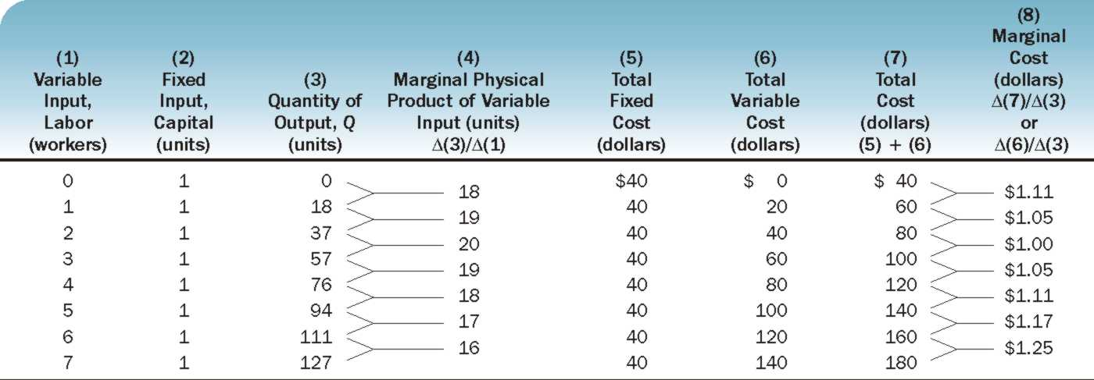
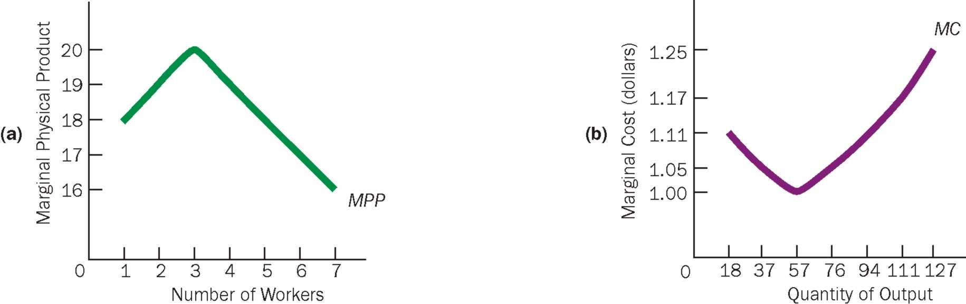
The Link Between MPP and MC

Slide 8
The Link Between MPP and MC
Marginal cost is a reflection of the marginal physical product of the variable input.
As the marginal physical product curve rises, the marginal cost curve falls; and as the marginal physical product curve falls, the marginal cost curve rises.
What the marginal cost curve looks like depends on what the marginal physical product curve looks like.
As MPP rises ➔ productivity of the variable input increases (more output being produced using same input) ➔ costs decline ➔ MC falls
Vice versa!

Slide 9
Another Way to Look at the relationship between MPP and MC.
MC = ∆TC/∆Q
MPP = Change in output that results from changing the variable input by one unit, holding all else constant.
Labour is the only variable output, with Wage being set per worker and labour being increased by one worker every time.
∆TC = ∆TVC = W (Wage is the only variable cost)
∆Q = change in output that results from changing one unit of variable input, that is increasing worker by one ➔ ∆Q = MPP
MC = W/MPP

Slide 10
Average Productivity
Average physical product is output divided by the quantity of labor.
When the term labor productivity is used in the newspaper and in government documents, it refers to the average physical productivity of labor on an hourly basis.
Government statisticians chose a base year, set it equal to 100 and calculate productivity indices to compare labour productivity across years and across countries.

Slide 11
Costs of Production: Total, Average, Marginal
The Average Fixed Cost (AFC) = Total fixed cost divided by quantity of output. AFC = TFC/Q
The Average Variable Cost (AVC) = Total variable cost divided by quantity of output. AVC = TVC/Q
The Average Total Cost (ATC) or Unit Cost= Total Cost divided by quantity of output. ATC = TC/Q or ATC = AFC + AVC
The Marginal Cost is the change in total cost or total variable cost that results from a change in output. ∆TC/∆Q

Slide 12
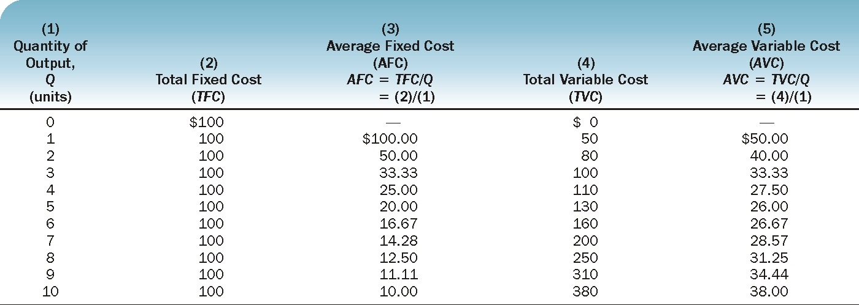
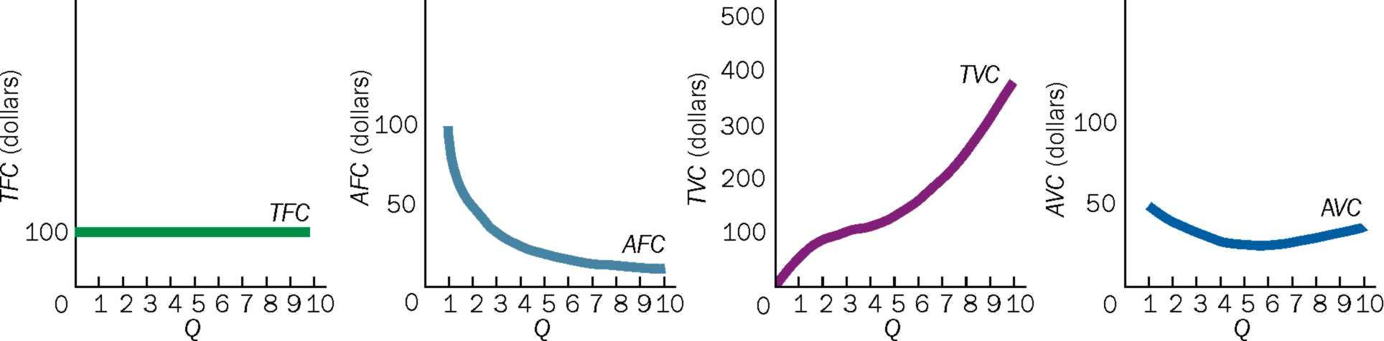

Slide 13
